Slide 1

Programming Fundamentals & Higher Order Programming

Slide 2
Programming Paradigms
Imperative
Procedural
Functional
Object-oriented
Logic
Styles of coding
Notes:
Programming Paradigms are Styles of coding. Using different paradigms forces you to think differently, to approach problems differently. It’s as if they’re different tools, and you must choose one to solve a problem. There are many programming paradigms. I’ll be talking about these 5.

Slide 3








Imperative Programming
Do this
If something, then do this
Do this
Then do this
Real-life Example: Baking a cake
Pour flour into a bowl
Crack 2 eggs into the bowl
Pour milk into the bowl
Mix it
Pour the mix into a mold
Bake in oven for 30 minutes
Let it chill for 5 minutes
Notes:
You are a programmer. You want your computer to do stuff. With imperative programming, you make the computer do stuff by explicitly telling it each and every instruction. To make a cake in reak-life, you may create a step-by-step list with the following:

Slide 4
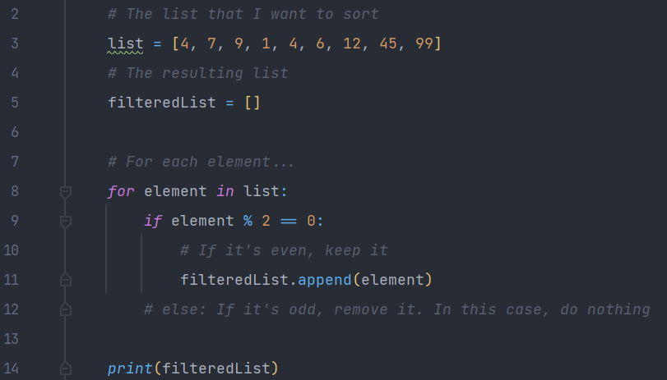
Imperative Programming
Code example: Filtering out the odd numbers in a list (in Python, since its syntax is great for reading and writing)
If the first element is an even number, keep it
If the first element is an odd number, remove it
If the second element is an even number, keep it
…
or
For each element, if it’s even, keep it
For each element, if it’s odd, remove it

Slide 5
procedural Programming
Extends Imperative Programming
Real-life Example: Baking a cake (Imperative)
Pour flour into a bowl
Crack 2 eggs into the bowl
Pour milk into the bowl
Mix it
Pour the mix into a mold
Bake in oven for 30 minutes
Let it chill for 5 minutes
Procedure: Pour ingredients
Procedure: Mix and transfer to mold
Procedure: Bake and let chill
Real-life Example: Baking a cake (Procedural)
Real-life Example: Baking many muffins (Procedural)
Pour ingredients
Mix and transfer to mold
Bake and let chill
Pour ingredients x3
Mix and transfer to mold
Add fruits
Bake and let chill
Notes:
Procedural programming is an extension of imperative programming. In procedural programming, we split step-by-step instructions into procedures. This lets us be more organized when specifying an algorithm (or a recipe), and it lets us re-use procedures.

Slide 6
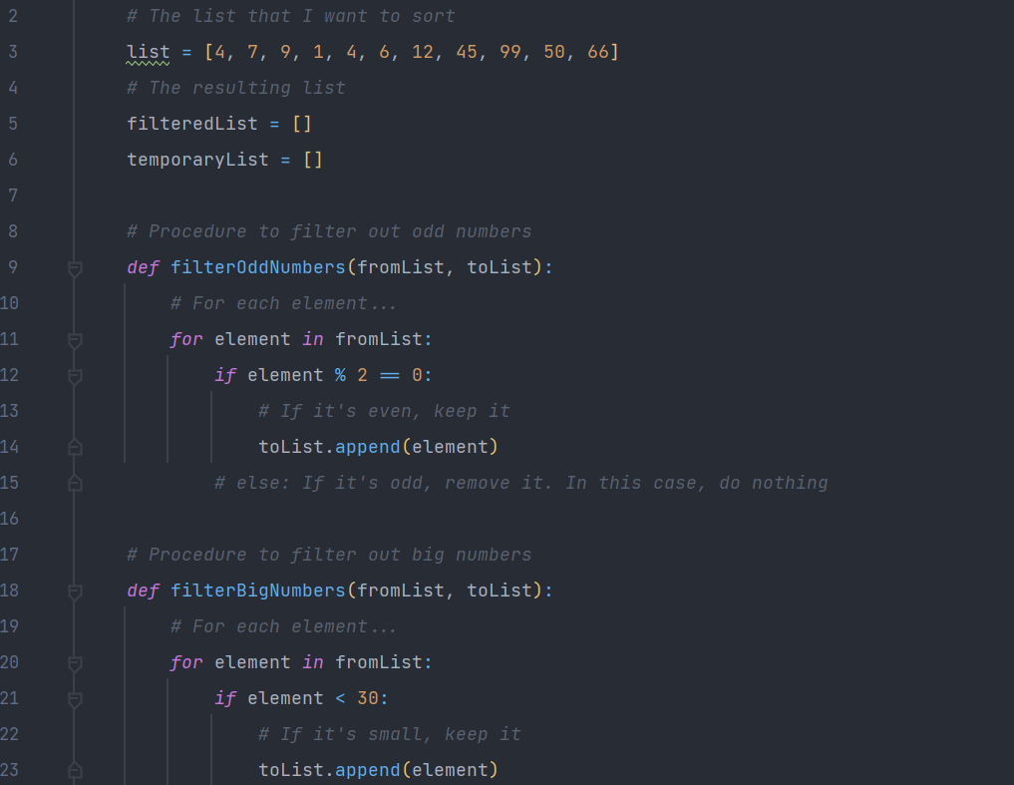
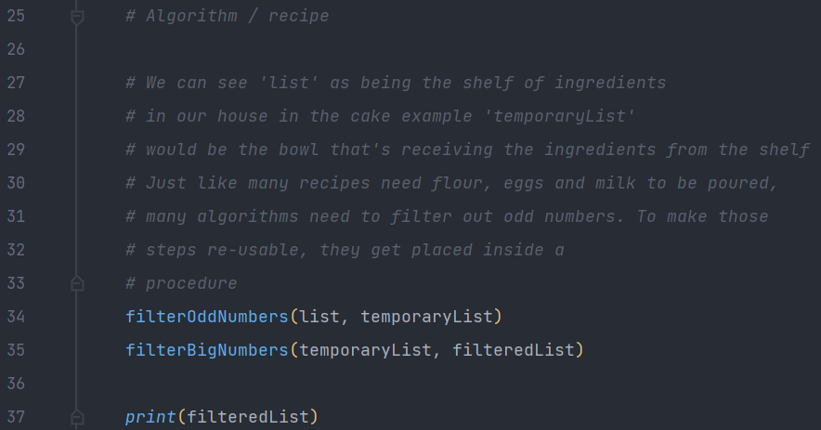
procedural Programming
Code example: Filtering out the odd and big numbers in a list (in Python)

Slide 7
functional Programming
First-class citizens:
Imperative instruction
If, else
For, while
First-class citizens:
Functions
How?
Second-class:
- Functions
Second-class:
- If, else
Higher Order Programming
Notes:
Functional Programming is a paradigm you’ve seen and probably used before, but not to it’s full potential. In a language whose only paradigm is functional, there are no variable declarations. There are no fors and whiles. Higher Order Programming is a consequence of Functional Programming

Slide 8
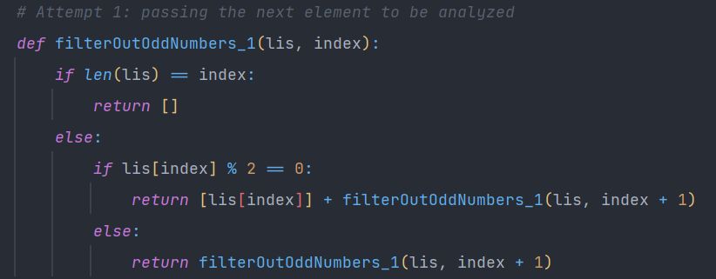
functional Programming
Code example: Filtering out the odd and big numbers in a list (in Python)
lis = [2,3,4,6,7], index = 0
len(lis) = 5, lis[0] = 2
1st iteration: return [2] + filter([2,3,4,6,7], 1)
lis = [2,3,4,6,7], index = 1
len(lis) = 5, lis[1] = 3
2nd iteration: return [2] + filter([2,3,4,6,7], 2)
lis = [2,3,4,6,7], index = 2
len(lis) = 5, lis[2] = 4
3rd iteration: return [2] + [4] + filter([2,3,4,6,7], 3)
lis = [2,3,4,6,7], index = 3
len(lis) = 5, lis[3] = 6
4th iteration: return [2] + [4] + [6] + filter([2,3,4,6,7], 4)
lis = [2,3,4,6,7], index = 4
len(lis) = 5, lis[4] = 7
5th iteration: return [2] + [4] + [6] + filter([2,3,4,6,7], 5)
lis = [2,3,4,6,7], index = 5
len(lis) = 5, lis[5] = out of bounds
6th iteration: return [2] + [4] + [6] + []
[2, 4, 6]

Slide 9
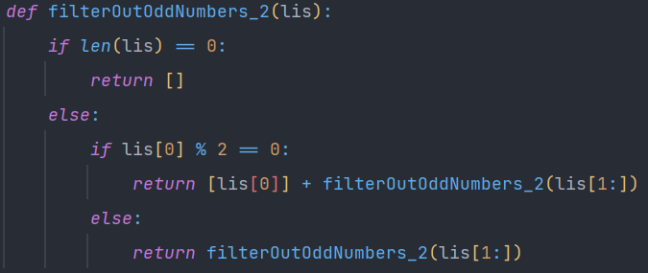
functional Programming
Code example: Filtering out the odd and big numbers in a list (in Python)
lis = [2,3,4,6,7]
len(lis) = 5 lis[0] = 2
1st iteration: return [2] + filter([3,4,6,7])
lis = [3,4,6,7]
len(lis) = 4 lis[0] = 3
0 1 2 3 4
2nd iteration: return [2] + filter([4,6,7])
[2,3,4,6,7]
lis = [4,6,7]
len(lis) = 3 lis[0] = 3
3rd iteration: return [2] + [4] + filter([6,7])
lis = [6,7]
len(lis) = 2 lis[0] = 6
4th iteration: return [2] + [4] + [6] + filter([7])
lis = [7]
len(lis) = 1 lis[0] = 7
5th iteration: return [2] + [4] + [6] + filter([])
lis = []
len(lis) = 0 lis[0] = out of bounds
6th iteration: return [2] + [4] + [6] + []
[2, 4, 6]

Slide 10

exercises

